Slide 1
Transfer learning, Inception Network

Slide 2
Transfer Knowledge
Humans have an inherent ability to transfer knowledge across tasks.
we acquire as knowledge while learning about one task,
=>we utilize in the same way to solve related tasks.
Know how to ride a motorbike ⮫ Learn how to ride a car
Know how to play classic piano ⮫ Learn how to play jazz piano
Know math and statistics ⮫ Learn machine learning
we don’t learn everything from scratch when we attempt to learn new aspects or topics.

Slide 3
Transfer Learning
Transfer learning is a method of reusing a model or knowledge for another related task.
In transfer learning, you can leverage knowledge (features, weights etc) from previously trained models for training newer models and even tackle problems like having less data for the newer task!
Transfer learning is something which data scientists and researchers believe can further our progress towards Artificial General Intelligence(AGI).
https://machinelearningmastery.com/how-to-use-transfer-learning-when-developing-convolutional-neural-network-models/

Slide 4
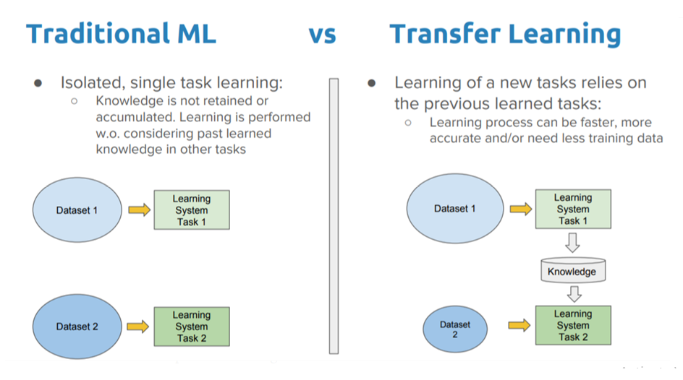

Slide 5
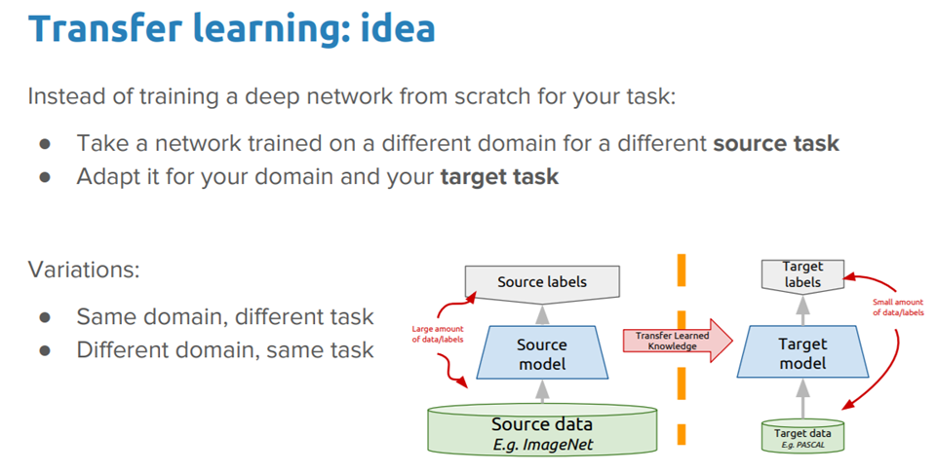
Transfer Learning

Slide 6
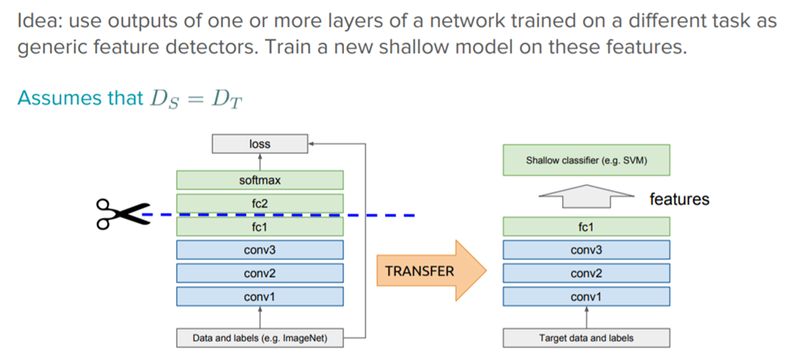
Transfer Learning

Slide 7
One-shot learning
Deep learning systems are data hungry by nature, such that they need many training examples to learn the weights. This is one of the limiting aspects of deep neural networks. though such is not the case with human learning.
For instance, once a child is shown what an apple looks like, they can easily identify a different variety of apple (with one or a few training examples);
One-shot learning is a variant of transfer learning where we try to infer the required output based on just one or a few training examples. This is essentially helpful in real-world scenarios where it is not possible to have labeled data for every possible class (if it is a classification task) and in scenarios where new classes can be added often.

Slide 8
Siamese Network for One-Shot Learning
One-shot learning is a classification task where one example (or a very small number of examples) is given for each class, that is used to prepare a model, that in turn must make predictions about many unknown examples in the future.
A Siamese network is an architecture with two parallel neural networks, each taking a different input, and whose outputs are combined to provide some prediction.
https://machinelearningmastery.com/one-shot-learning-with-siamese-networks-contrastive-and-triplet-loss-for-face-recognition/

Slide 9
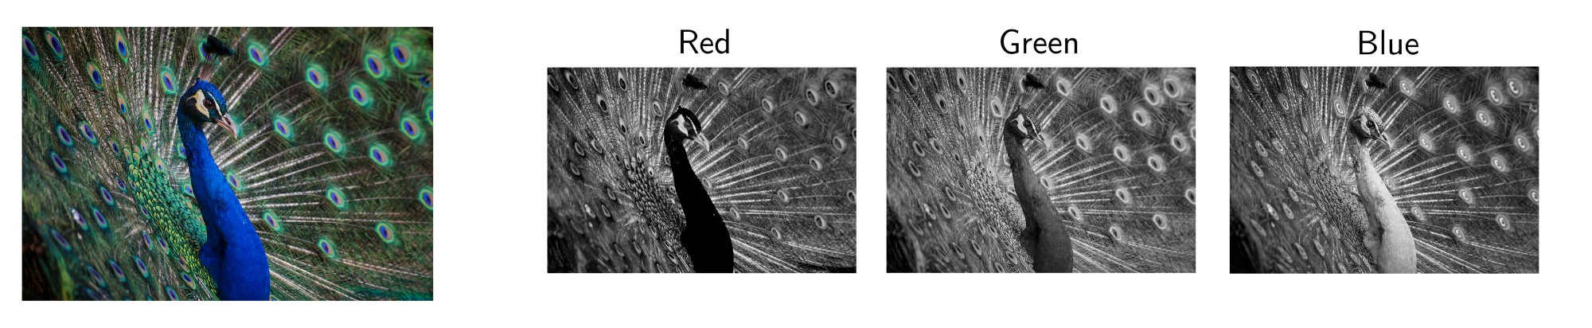
Input and Output Channels
Practicality, most input images have 3 channels
Each filter in a convolution layer produces one and only one output channel.

Slide 10
Output Channel
Each of the kernels of the filter “slides” over their respective input channels, producing a processed version of each.
Each of the per-channel processed versions are then summed together to form one channel. The kernels of a filter each produce one version of each channel, and the filter as a whole produces one overall output channel.

Slide 11
Dimensionality Reduction (DR)
In machine learning classification problems, there are often too many factors on the basis of which the final classification is done. These factors are basically variables called features.
The higher the number of features, the harder it gets to visualize the training set and then work on it.
Sometimes, most of these features are correlated, and hence redundant. This is where dimensionality reduction algorithms come into play.
Dimensionality reduction is the process of reducing the number of random variables under consideration, by obtaining a set of principal variables. It can be divided into feature selection and feature extraction.

Slide 12
Methods of Dimensionality Reduction
The various methods used for dimensionality reduction include:
Principal Component Analysis (PCA)
Linear Discriminant Analysis (LDA)
Generalized Discriminant Analysis (GDA)

Slide 13
Principal Component Analysis (PCA)
This method was introduced by Karl Pearson. It works on a condition that while the data in a higher dimensional space is mapped to data in a lower dimension space, the variance of the data in the lower dimensional space should be maximum.
It involves the following steps:
Construct the covariance matrix of the data.
Compute the eigenvectors of this matrix.
Eigenvectors corresponding to the largest eigenvalues are used to reconstruct a large fraction of variance of the original data.
Hence, we are left with a lesser number of eigenvectors, and there might have been some data loss in the process. But, the most important variances should be retained by the remaining eigenvectors.

Slide 14
Advantages & Disadvantages of DR
Advantages of Dimensionality Reduction
It helps in data compression, and hence reduced storage space.
It reduces computation time.
It also helps remove redundant features, if any.
Disadvantages of Dimensionality Reduction
It may lead to some amount of data loss.
PCA tends to find linear correlations between variables, which is sometimes undesirable.
PCA fails in cases where mean and covariance are not enough to define datasets.
We may not know how many principal components to keep- in practice, some thumb rules are applied.

Slide 15
Inception Network : Issues with previous Models
The major issues faced by deeper CNN models such as VGGNet were:
models is highly computationally expensive because of the deep architecture.
Very deep networks are susceptible to overfitting.
It is also hard to pass gradient updates through the entire network.

Slide 16
Inception Network
Inception net achieved a milestone in CNN classifiers when previous models were just going deeper to improve the performance and accuracy but compromising the computational cost.
The Inception network, on the other hand, is heavily engineered. It uses a lot of tricks to push performance, both in terms of speed and accuracy.
It is the winner of the ImageNet Large Scale Visual Recognition Competition in 2014.
The design of this initial Inception Module is known commonly as GoogLeNet, or Inception v1. Additional variations to the inception module have been designed, reducing issues such as the vanishing gradient problem.

Slide 17
What is an Inception Module/ layer?
Inception Modules are used in Convolutional Neural Networks to allow for more efficient computation and deeper Networks through a dimensionality reduction with stacked 1×1 convolutions.
The modules were designed to solve the problem of computational expense, as well as overfitting, among other issues. The solution, in short, is to take multiple kernel filter sizes within the CNN, and rather than stacking them sequentially, ordering them to operate on the same level.
Inception Modules are incorporated into convolutional neural networks (CNNs) as a way of reducing computational expense

Slide 18
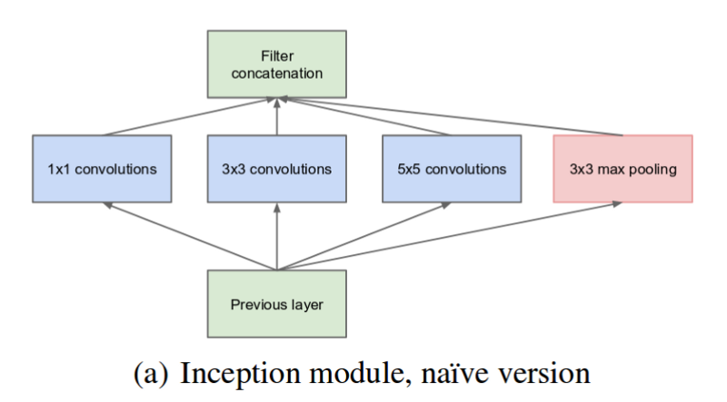
How does an Inception Module work?

Slide 19
How does an Inception Module work?
The most simplified version of an inception module works by performing a convolution on an input with not one, but three different sizes of filters (1x1, 3x3, 5x5).
Also, max pooling is performed. Then, the resulting outputs are concatenated and sent to the next layer.
By structuring the CNN to perform its convolutions on the same level, the network gets progressively wider, not deeper.
By doing so, the number of input channels is limited and 1x1 convolutions are far cheaper than 5x5 convolutions. It is important to note, however, that the 1x1 convolution is added after the max-pooling layer, rather than before.

Slide 20
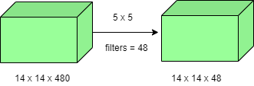
Inception Network
1 X 1 convolution: A 1×1 convolution simply maps an input pixel with all its respective channels to an output pixel. 1×1 convolution is used as a dimensionality reduction module to reduce computation to an extent.
For instance, we need to perform 5×5 convolution without using 1×1 convolution as below:
Number of operations involved here is (14×14×48) × (5×5×480) = 112.9M

Slide 21
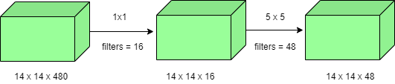
Inception Network
Using 1×1 convolution:
Number of operations for 1×1 convolution = (14×14×16) × (1×1×480) = 1.5M Number of operations for 5×5 convolution = (14×14×48) × (5×5×16) = 3.8M After addition we get, 1.5M + 3.8M = 5.3M
Which is immensely smaller than 112.9M ! Thus, 1×1 convolution can help to reduce model size which can also somehow help to reduce the overfitting problem.

Slide 22
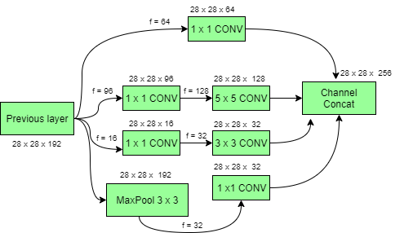
Inception model with dimension reductions

